Slide 1

CrowdStrike Hackathon - Every Second Counts

Slide 2
Team Name: Hash21
Theme Name: Hop Count
Team Members:Ishan Singhal Sahil Agarwal Gaurang Mittal Akash Chaturvedi

Slide 3
Background: Identify the problem
The problem to be solved here is to find the shortest path between the source and destination.

Slide 4
Definition: Which problem are you trying to solve and why?
We are trying to find the minimum transitions an airline has to make to reach from source to destination .The solution will help to minimize the travel time taken by the Airline to go from one point to another.

Slide 5
Solution: How your idea is solving the problem and making a positive impact on customer experience
The algorithm we used here is Dijkstras (single source shortest path algorithm ) which is a greedy approach to solve the problem.

Slide 6
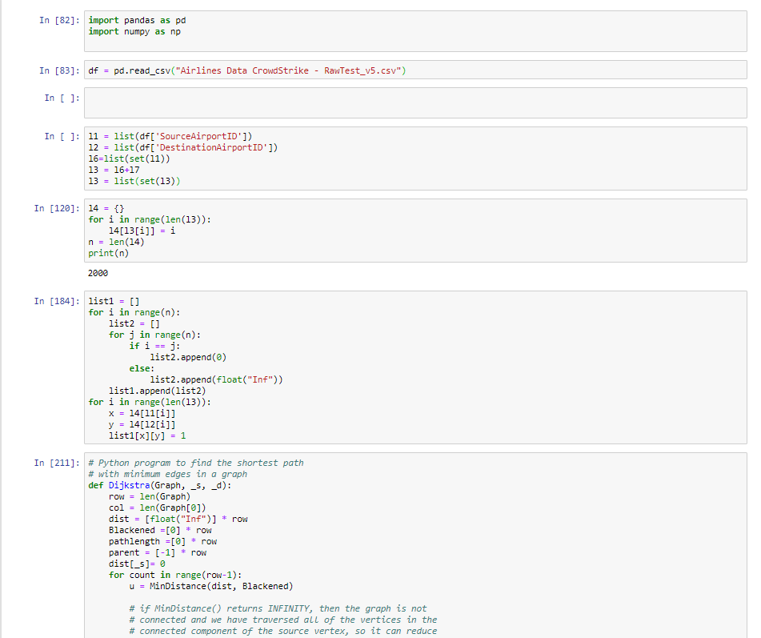
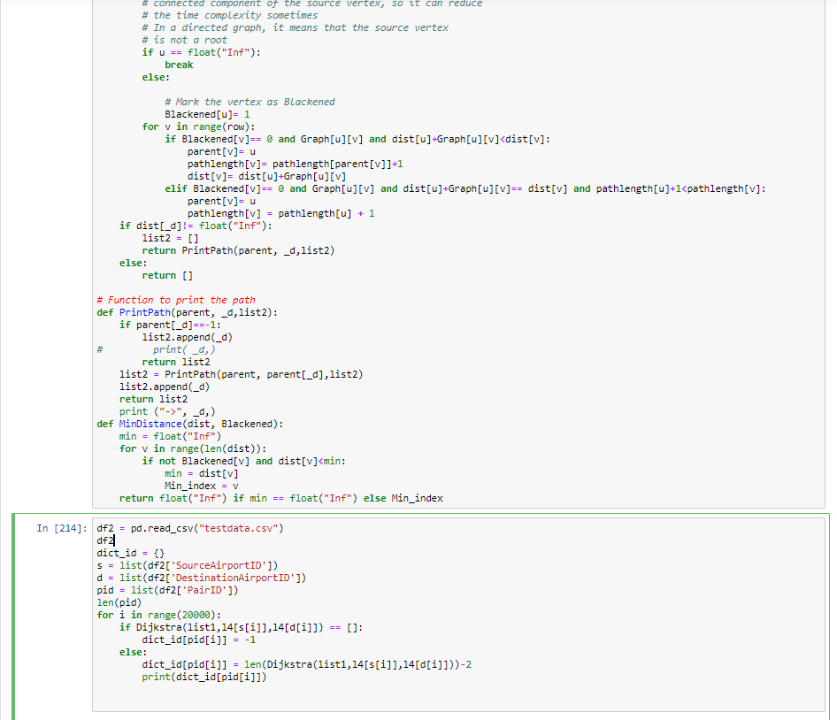
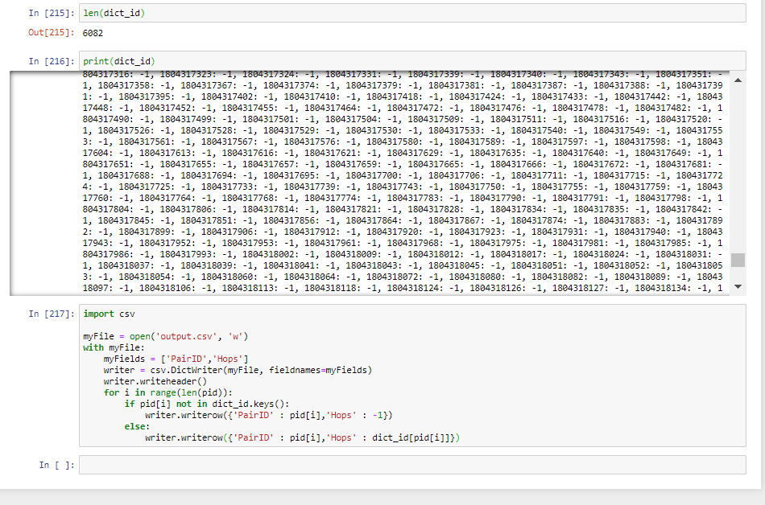
Deliver: Share images of your solution or prototype or provide a demo video link

